Slide 1
Analysis of MTA Data
Project 1
Jonathan Liu, Hans Remy, Benjamin Lu

Slide 2
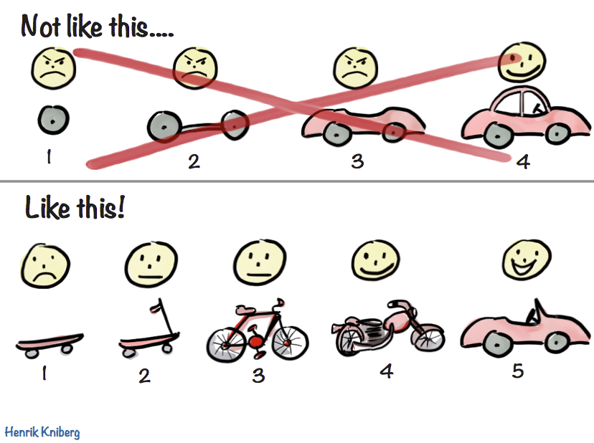

Metis Insights Everywhere
Iterate Responsibly and With Safety Measures:
Code hygiene → Road sense Pickled data file → Helmet

Slide 3
Objective
“WomenTechWomenYes (WTWY) has an annual gala at the beginning of the summer each year. As we are new and inclusive organization, we try to do double duty with the gala both to fill our event space with individuals passionate about increasing the participation of women in technology, and to concurrently build awareness and reach.
To this end we place street teams at entrances to subway stations. The street teams collect email addresses and those who sign up are sent free tickets to our gala.”

Slide 4
Breaking Down the Objective
Dimension | Focus | Further Analysis
..annual gala beginning of the summer this year | - First 6 months of the year | - Are there noticeable trends month to month? E.g due to weather
..fill our event space.. Build awareness and reach | - Top X stations with highest footfall | - Might the data suggest the profile of such footfall? E.g locals, tourists, students?
..place street teams | - Trended footfall within stations | - Are there particular days that have higher footfall on average? - Within the day, what is the footfall like?

Slide 5
Preliminary
Data Analysis

Slide 6
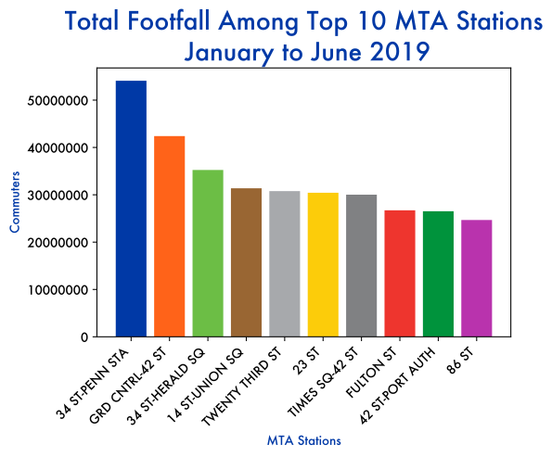
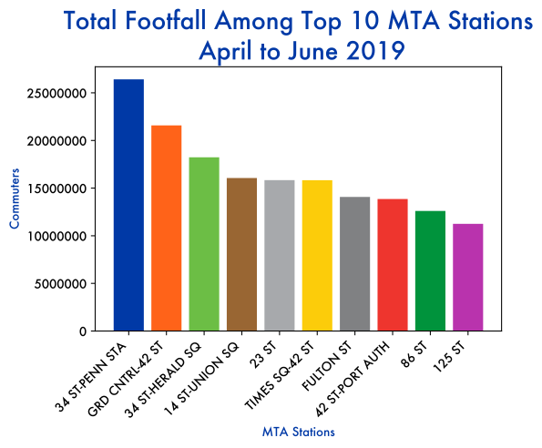
Footfall Volume and Consistency
Footfall Jan to June 2019 Top 3 stations: ~130M footfall (~40%) Next 7 stations: ~210M footfall
Footfall Apr to June 2019 Top 3 stations: ~65M footfall (~40%) Next 7: ~100M footfall
Commuters
MTA Stations
Clear and Consistent Footfall across top 10 Stations

Slide 7
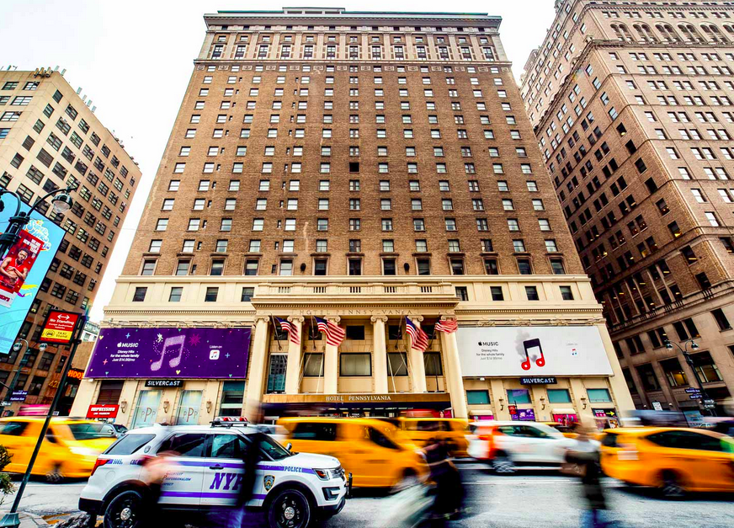
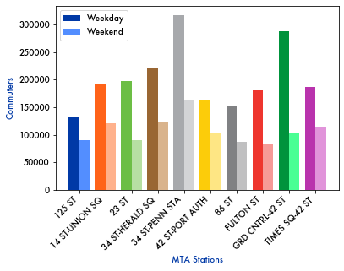
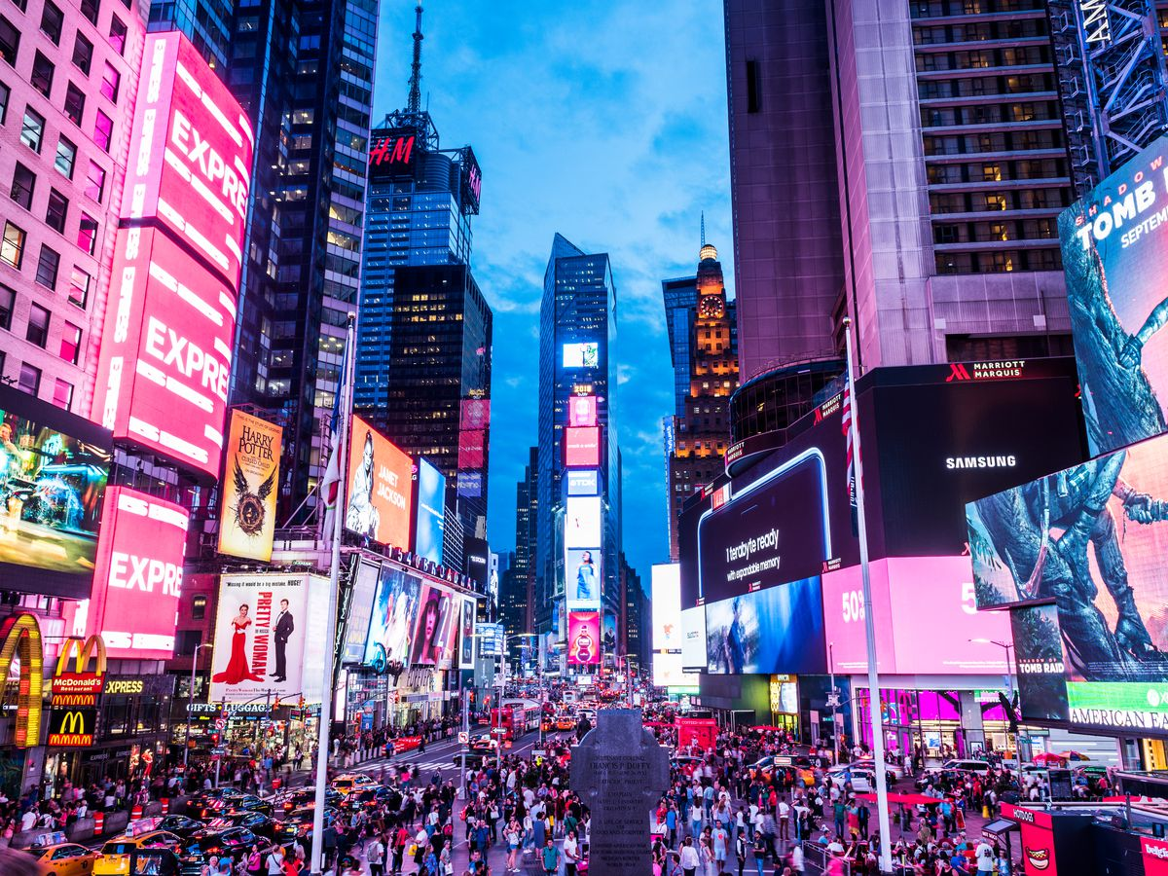
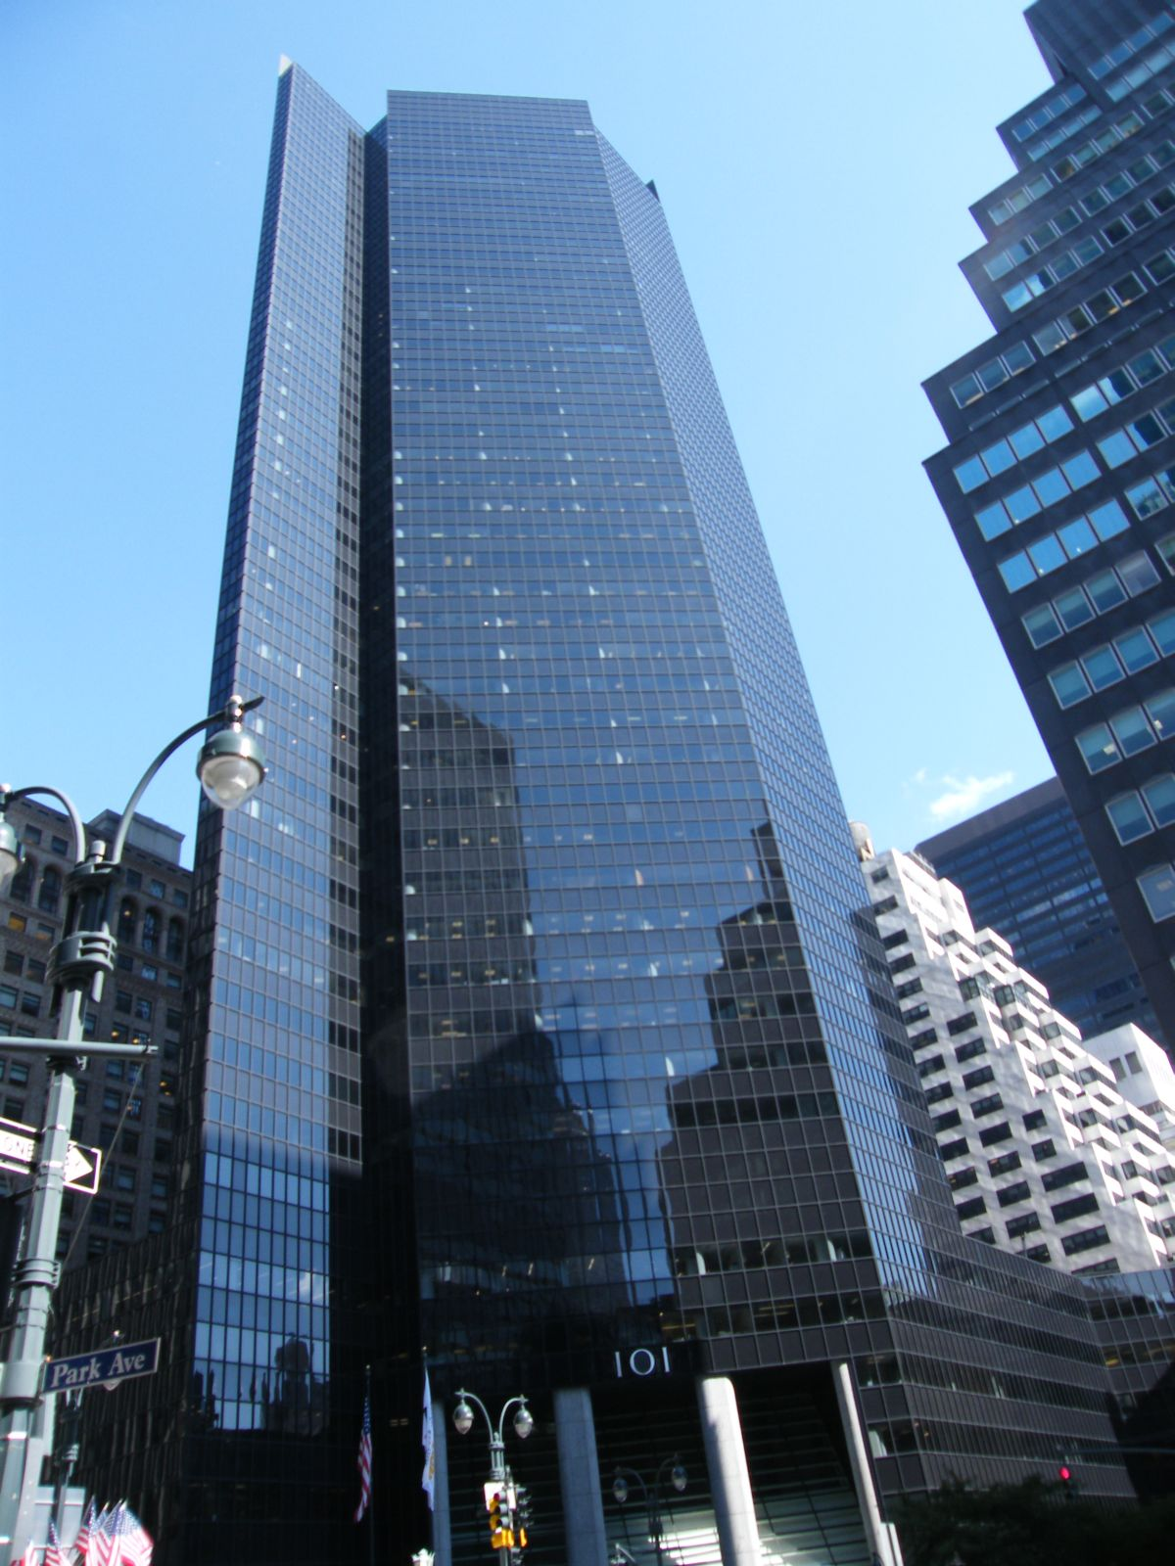
Footfall Breakdown by Week
Top 10 Stations Jan - June 2019
Commuters
MTA Stations
Data suggestive of local and tourist commuter patterns

Slide 8
Optimizing
Street Teams

Slide 9
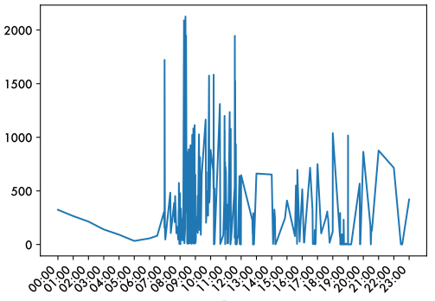
Tracking 24 Hour Footfall
34 St Penn Station Jan - June 2019
Notable Spikes in Commuter Traffic - Might suggest “rushed” commute - Focus on flier distribution - Visual publicity - General mass marketing
Easing of volume and traffic intensity - Might suggest leisurely commute - One to one engagement - Interactive booths/panels - Targeted impact & high conversion rates
Tailor Outreach to Commuter Travel Patterns

Slide 10
Recommendations
Macro Strategy
Target 3 busiest stations of 34 St & Penn, 34 St & Herald Sq, Grand Central
Target weekdays for higher local footfall
Micro Strategy
Commuter travel patterns suggest morning might be good for mass outreach; afternoons may be good for tailored engagement

Slide 11
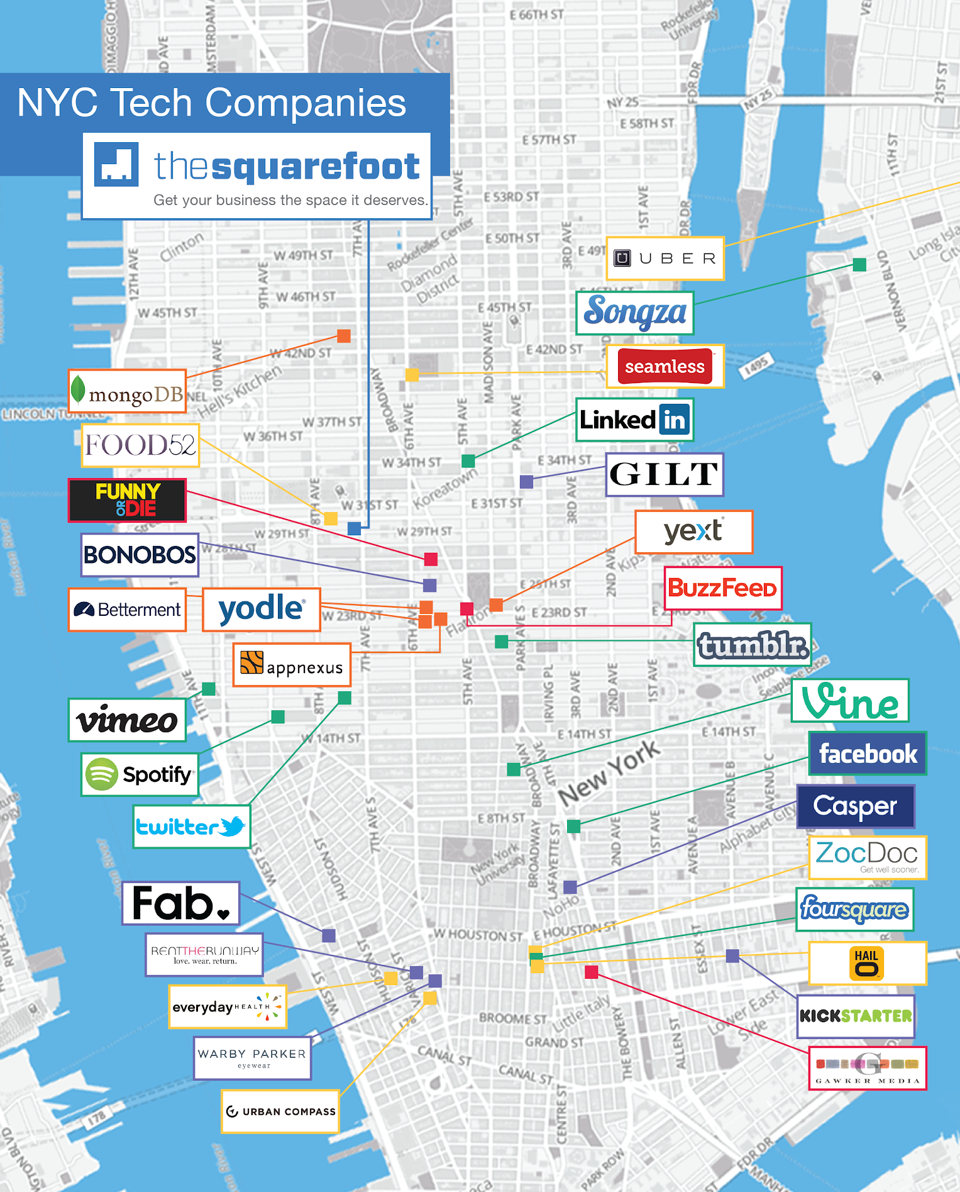
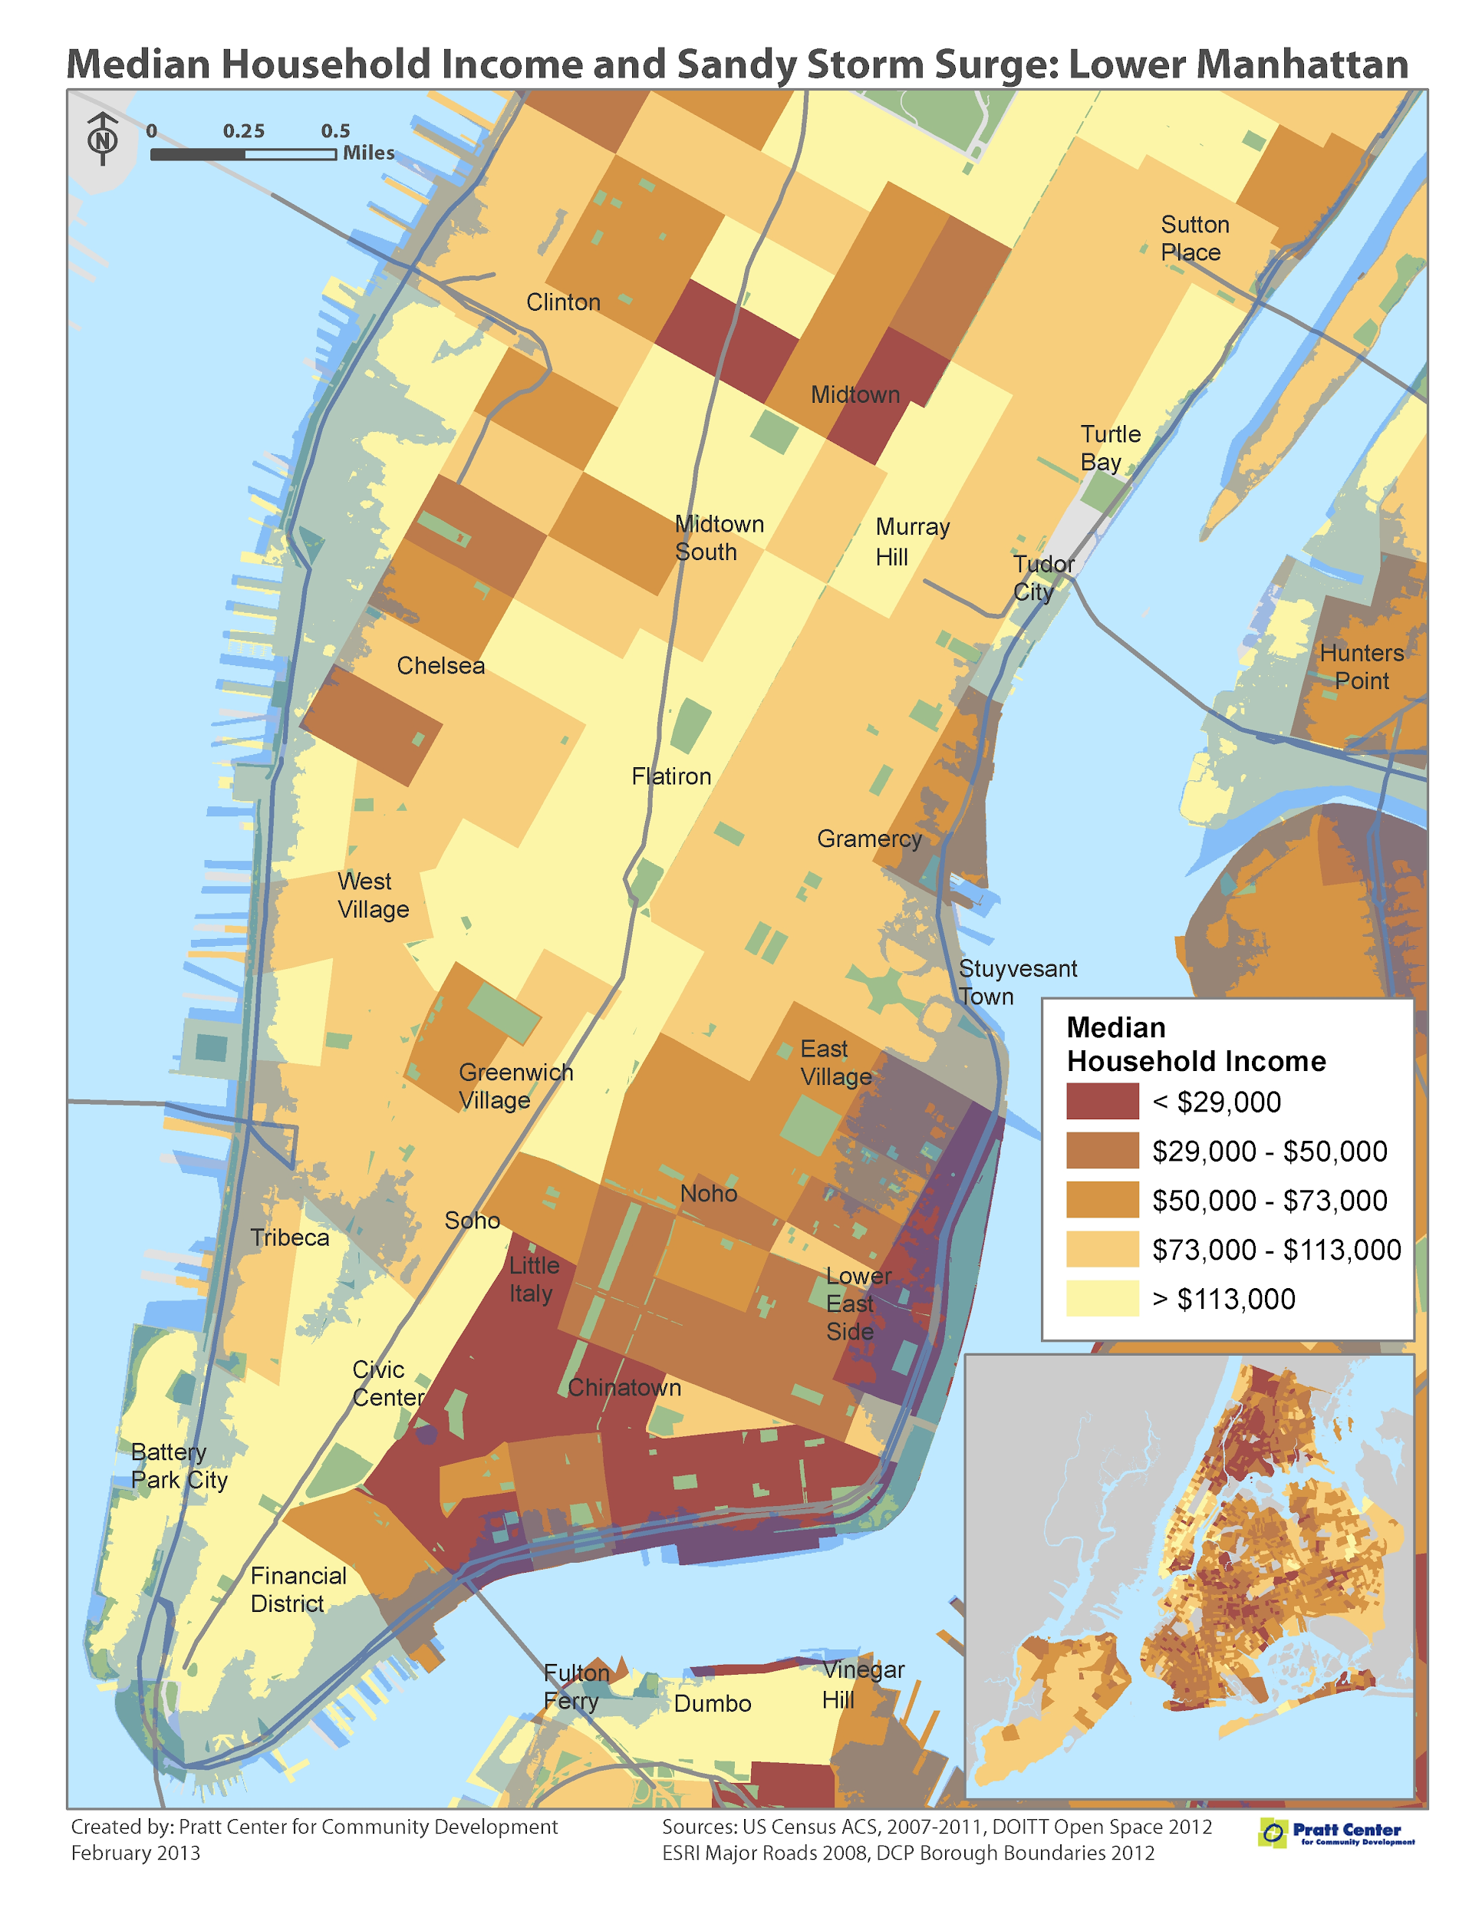
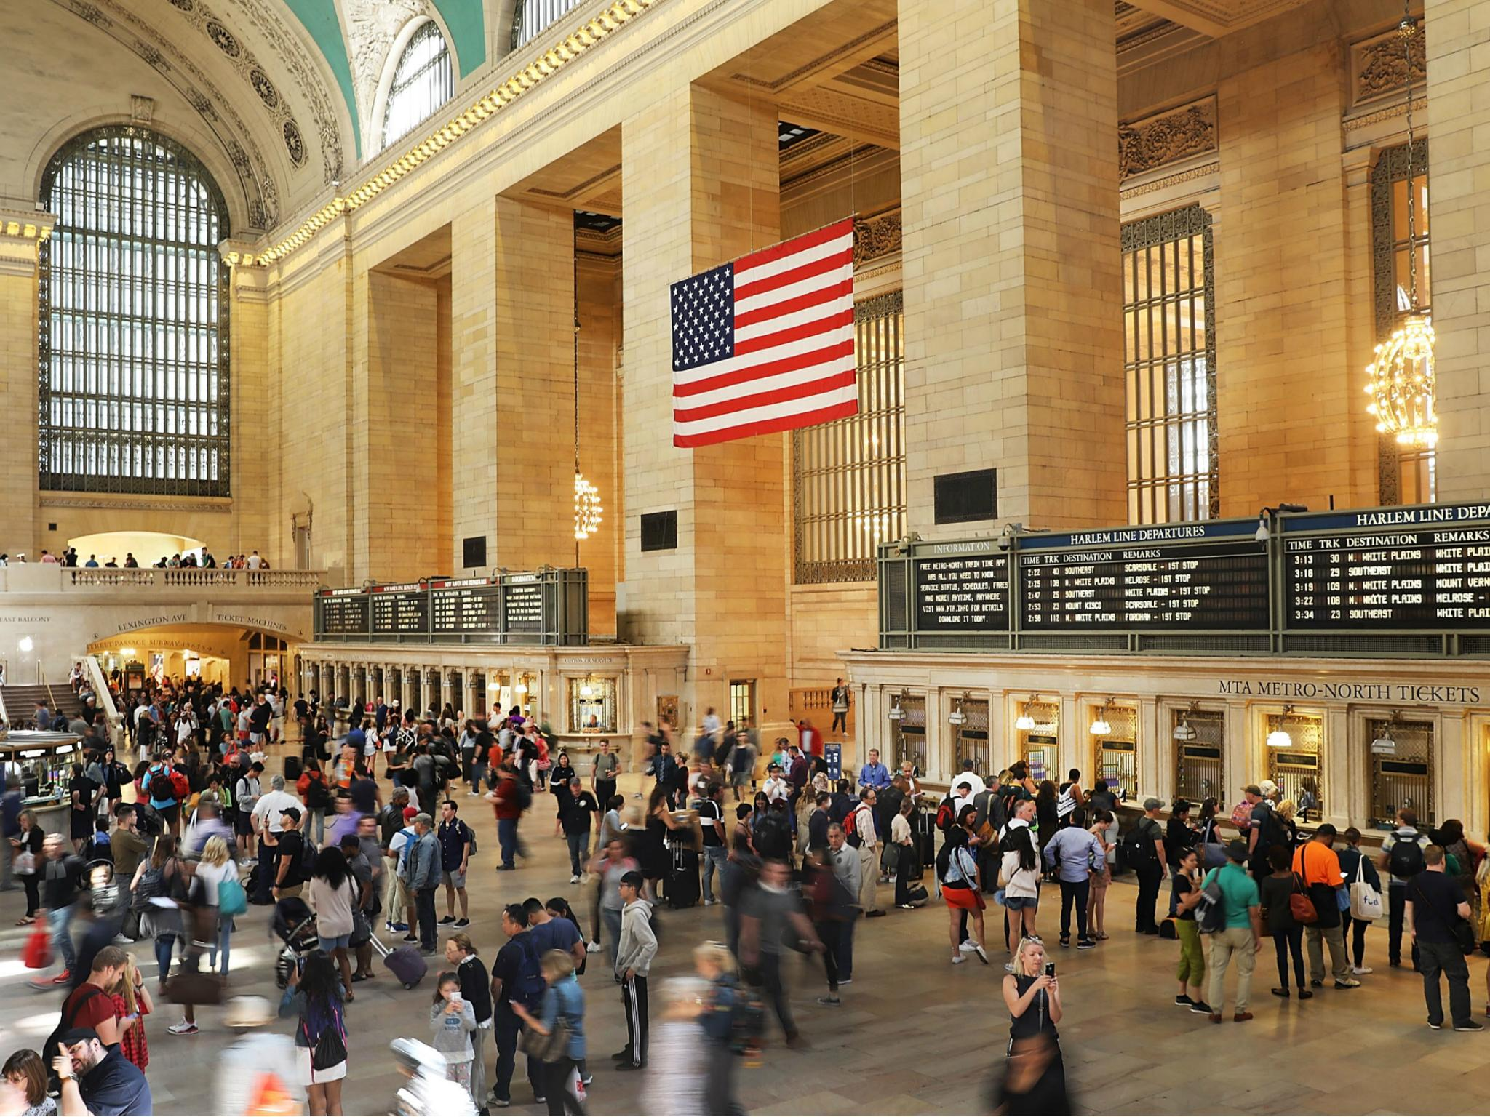
Further Study
Enhance campaign relevance - Factor in station proximity to “tech hubs”
Increase exposure to potential donors - Analysis by household income data (e.g by zip code)
Optimize street team exit placement - Deep dive into turnstile data

Slide 12

Women Tech
Women Yes!

